Slide 1

Chapter 7
Relational Database Design by ER- and EERR-to-Relational Mapping

Slide 2
Chapter Outline
ER-to-Relational Mapping Algorithm
Step 1: Mapping of Regular Entity Types
Step 2: Mapping of Weak Entity Types
Step 3: Mapping of Binary 1:1 Relation Types
Step 4: Mapping of Binary 1:N Relationship Types.
Step 5: Mapping of Binary M:N Relationship Types.
Step 6: Mapping of Multivalued attributes.
Mapping EER Model Constructs to Relations
Step 7: Options for Mapping Specialization or Generalization.

Slide 3
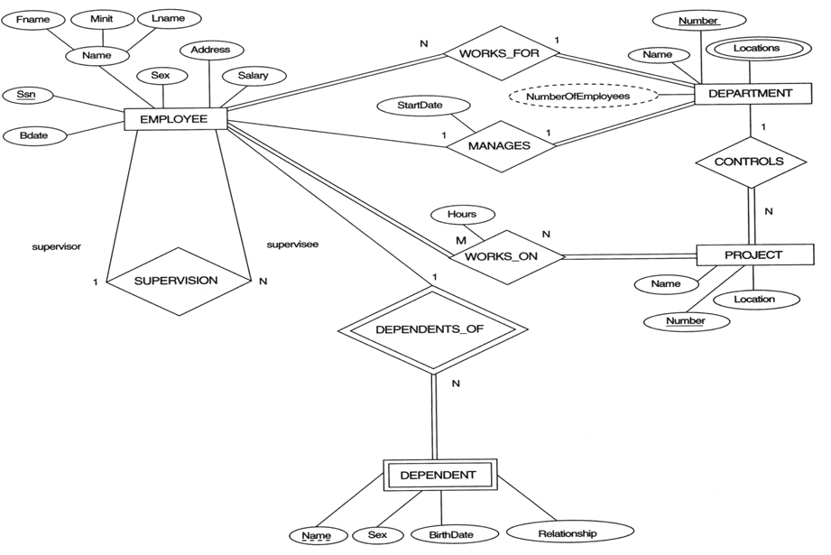
The ER conceptual schema diagram for the COMPANY database.

Slide 4

Result of mapping the COMPANY ER schema into a relational schema.

Slide 5
ER-to-Relational Mapping Algorithm
Step 1: Mapping of Regular Entity Types.
  For regular entity type E in ER schema, create a relation R that includes all the simple attributes, and component attributes of composite attributes. Select the primary key.
  Example:
  We create the relations EMPLOYEE, DEPARTMENT, and PROJECT in the relational schema corresponding to the regular entities in the ER diagram.
  SSN, DNUMBER, and PNUMBER are the primary keys for the relations EMPLOYEE, DEPARTMENT, and PROJECT as shown.

Slide 6
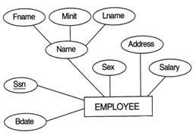
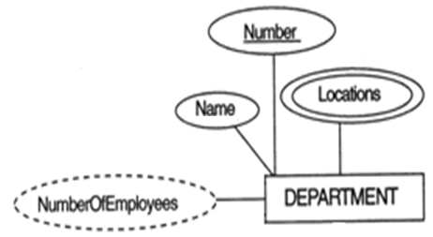

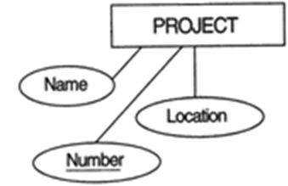



Slide 7
ER-to-Relational Mapping Algorithm
Step 2: Mapping of Weak Entity Types
  For weak entity type W in ER schema, with owner entity type E, create a relation R, include all simple or composite attributes of W as attributes of R. In addition, include the primary key attributes of the relation Q for the owner entity type E. Primary key is the combination of primary key of Q and partial key of R.
  Example: Create the relation DEPENDENT in this step to correspond to the weak entity type DEPENDENT. Include the primary key SSN of the EMPLOYEE relation as a foreign key attribute of DEPENDENT (renamed to ESSN).
  The primary key of the DEPENDENT relation is the combination {ESSN, DEPENDENT_NAME} because DEPENDENT_NAME is the partial key of DEPENDENT.

Slide 8
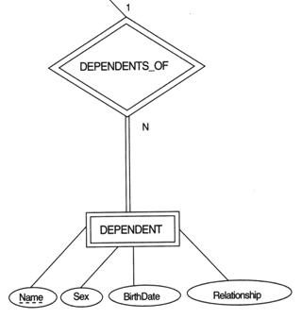


Slide 9
ER-to-Relational Mapping Algorithm
Step 3: Mapping of Binary 1:1 Relation Types
  For 1:1 relationship X, suppose S and T are the relations for the entity types participating in it. Include primary key of T as foreign key of S. Include other attributes of the relationship X as attributes of S.
Example: 1:1 relation MANAGES is mapped by choosing the participating entity type DEPARTMENT to serve in the role of S, because its participation in the MANAGES relationship type is total.

Slide 10
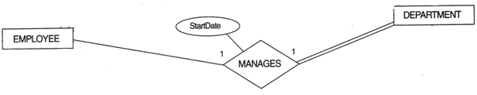


Slide 11
ER-to-Relational Mapping Algorithm
Step 4: Mapping of Binary 1:N Relationship Types.
  For each 1:N relationship Y, suppose S relation corresponds to the entity type at the N-side, and T relation corresponds to the entity type at the other side. Include primary key of T as foreign key of S.
  Include any simple attributes of the 1:N relation type as attributes of S.
  Example: 1:N relationship types WORKS_FOR, CONTROLS, and SUPERVISION in the figure. For WORKS_FOR we include the primary key DNUMBER of the DEPARTMENT relation as foreign key in the EMPLOYEE relation and call it DNO.

Slide 12
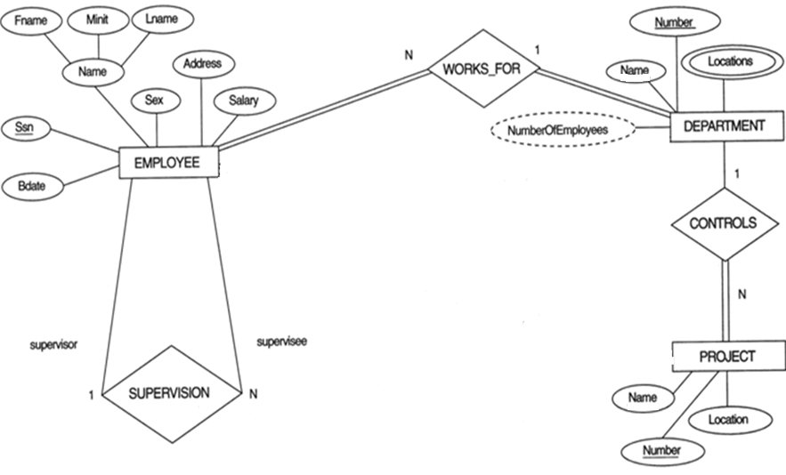


Slide 13
ER-to-Relational Mapping Algorithm
Step 5: Mapping of Binary M:N Relationship Types.
  For each M:N relationship Z between S an T, create a new relation R to represent Z. Include simple attributes of Z in R. Include the primary keys of S and T as foreign keys of R, their combination forms the primary key of R.
  Example: The M:N relationship type WORKS_ON from the ER diagram is mapped by creating a relation WORKS_ON in the relational database schema. The primary keys of the PROJECT and EMPLOYEE relations are included as foreign keys in WORKS_ON and renamed PNO and ESSN, respectively.
  Attribute HOURS in WORKS_ON represents the HOURS attribute of the relation type. The primary key of the WORKS_ON relation is the combination of the foreign key attributes {ESSN, PNO}.

Slide 14
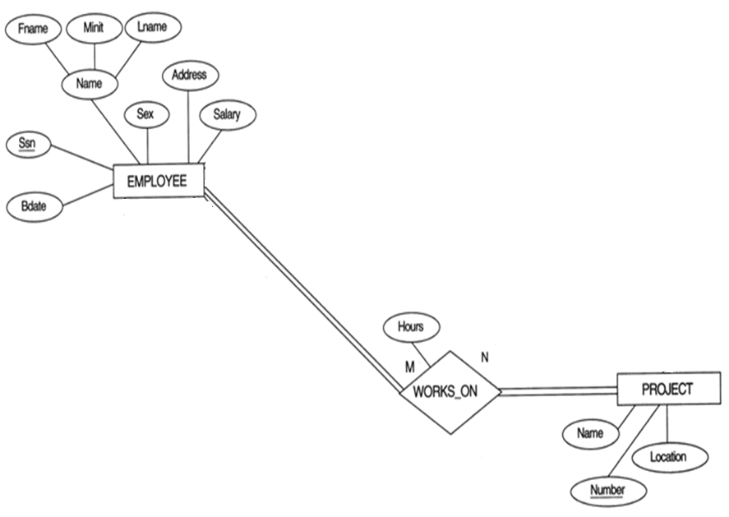


Slide 15
ER-to-Relational Mapping Algorithm
Step 6: Mapping of Multivalued attributes.
  For each multivalued attribute A, create a new relation R that includes an attribute corresponding to A. Include primary key of the relation of the entity type having A as an attribute. Primary key is their combination.
  Example: The relation DEPT_LOCATIONS is created. The attribute DLOCATION represents the multivalued attribute LOCATIONS of DEPARTMENT, while DNUMBER-as foreign key-represents the primary key of the DEPARTMENT relation. The primary key of R is the combination of {DNUMBER, DLOCATION}.

Slide 16
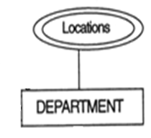


Slide 17
Summary of Mapping constructs and constraints
ER Model Relational Model
Entity type “Entity” relation (table)
1:1 or 1:N relationship type Foreign key
M:N relationship type new relation and foreign keys
Simple attribute Attribute
Composite attribute Set of simple component attributes
Multivalued attribute New relation and foreign key
Key attribute Primary key

Slide 18
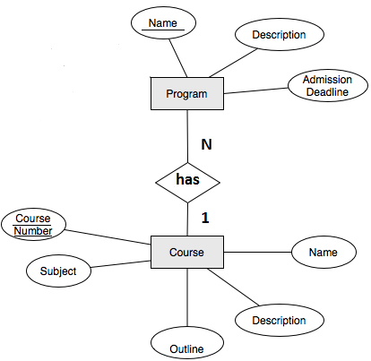
Mapping Exercise (1)

Slide 19
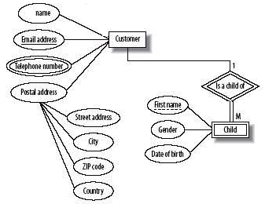
Mapping Exercise (2)

Slide 20
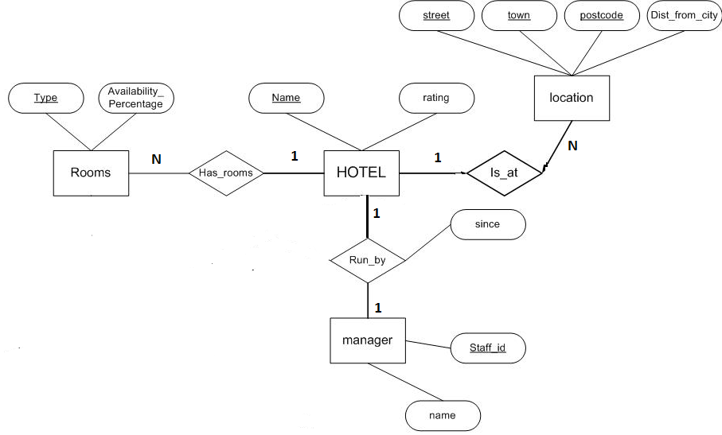
Mapping Exercise (3)

Slide 21
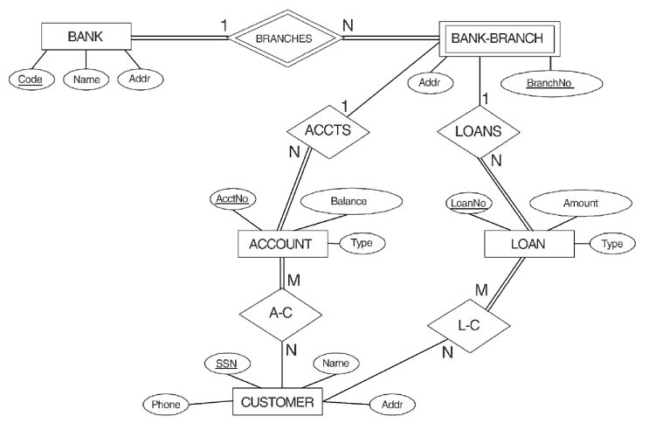
Mapping Exercise (4)

Slide 22
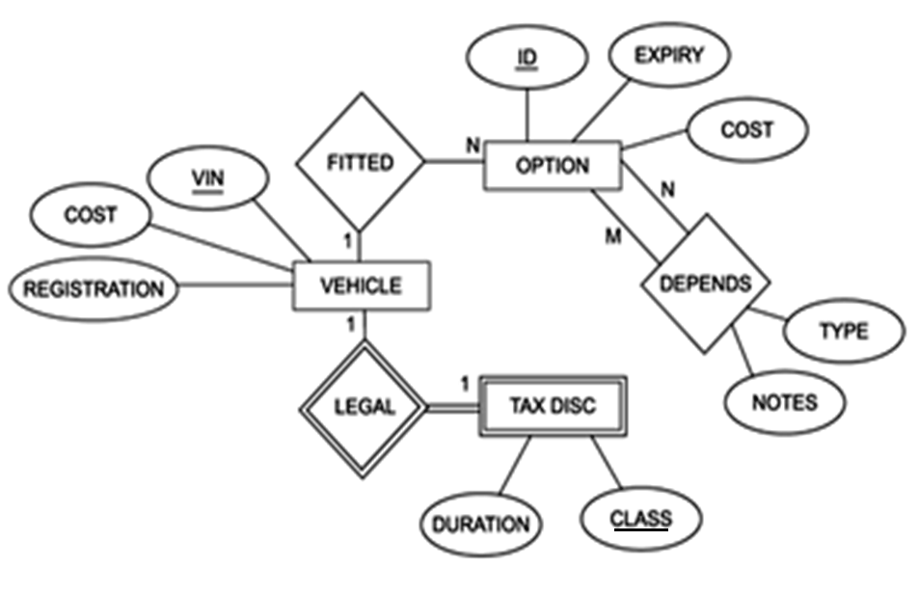
Mapping Exercise (5)

Slide 23
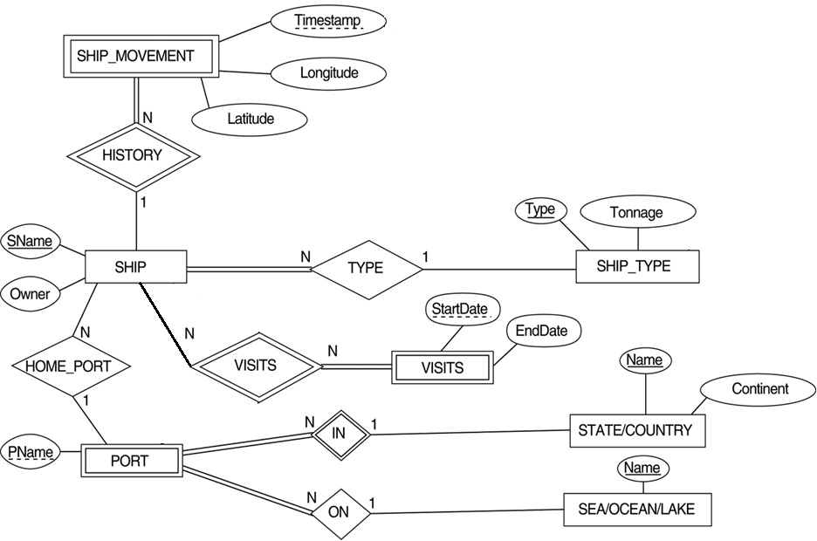
Mapping Exercise (6)

Slide 24
Mapping EER Model Constructs to Relations
Relational databases do not support inheritance
Two possibilities to map an inheritance association to a database schema
Vertical mapping:
  The attributes of the superclass and the subclasses are mapped to different tables (Add the primary key of the superclass table as a primary key in the subclass tables)
Horizontal mapping:
  There is no table for the superclass: each subclass is mapped to a table containing the attributes of the subclass and the attributes of the superclass

Slide 25

EER diagram notation for an attribute-defined specialization on JobType.

Slide 26
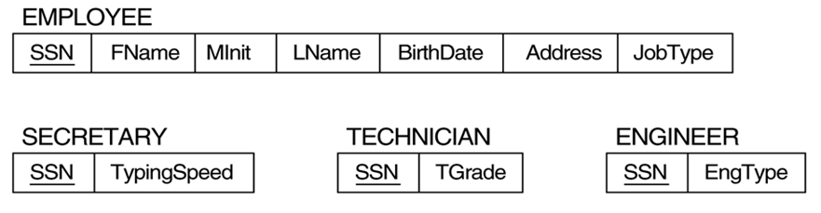
-Vertical Mapping:

Slide 27
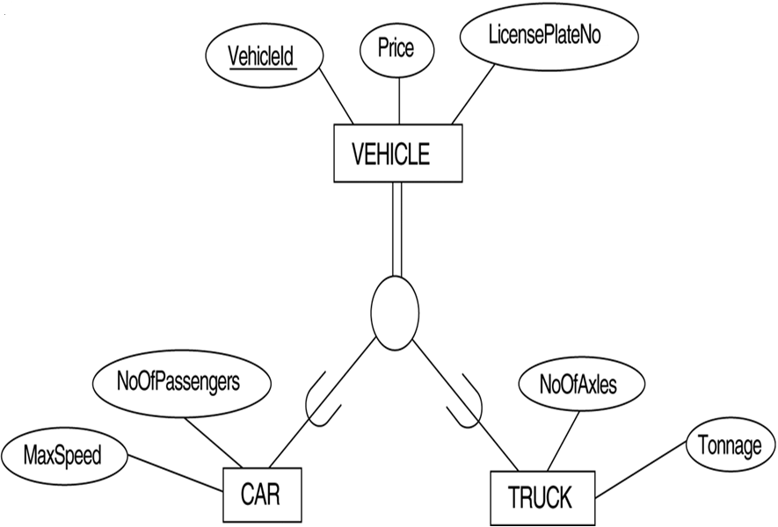


Slide 28
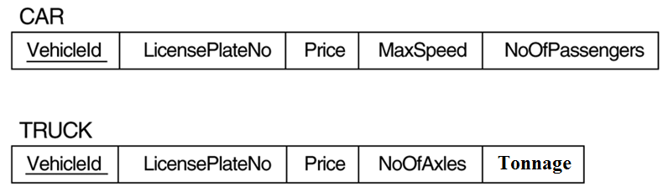
-Horizontal Mapping:

Slide 29
Mapping EER Model Constructs to Relations (cont)
Mapping of Shared Subclasses (Multiple Inheritance)
A shared subclass, such as STUDENT_ASSISTANT, is a subclass of several classes, indicating multiple inheritance. These classes must all have the same key attribute; otherwise, the shared subclass would be modeled as a category.
We can apply any of the options discussed in Step 7 to a shared subclass

Slide 30

Mapping Exercise (7) A specialization lattice with multiple inheritance for a UNIVERSITY database.

Slide 31
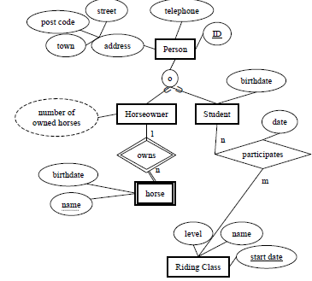
Mapping Exercise (8)

